Slide 1
Twitter Sentiment Analysis
BY:
Likhitha Vanga
Shashank Shekhar

Slide 2
About Project & Objective
In today's world where information is readily available and at your fingertips, we think and believe that the paradigm of how stocks rise and fall based on information has changed in a way where we can use data science to use available data to decide if the outcome will cause a positive or negative impact.

Slide 3
Twitter Sentiment Analysis
Sentiment Analysis is the automated process of analyzing text data and sorting it into sentiments positive, negative, or neutral.
Performing Sentiment Analysis on data from Twitter using machine learning can help companies understand how people are talking about their brand.
Monitoring Twitter allows companies to understand their audience, keep on top of what’s being said about their brand and their competitors, and discover new trends in the industry. Are users talking positively or negatively about a product?

Slide 4
Why Twitter?
Twitter allows businesses to reach a broad audience and connect with customers without intermediaries.
Tweets are small in length and hence unambiguous.

Slide 5
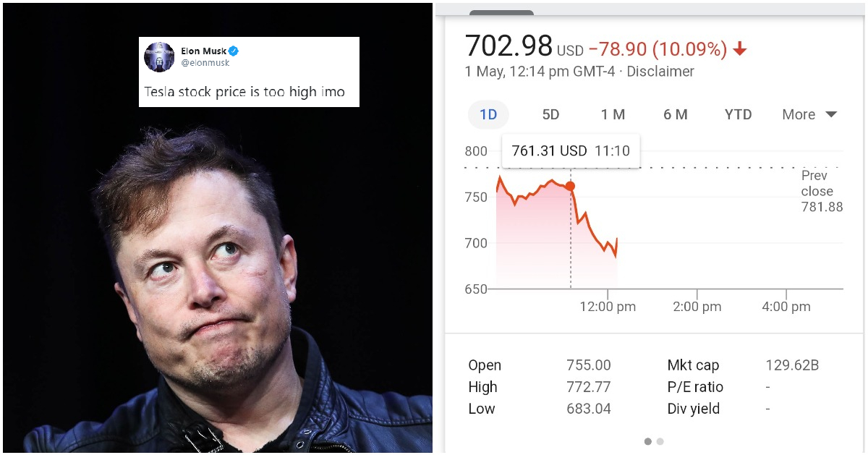
Approach

Slide 6
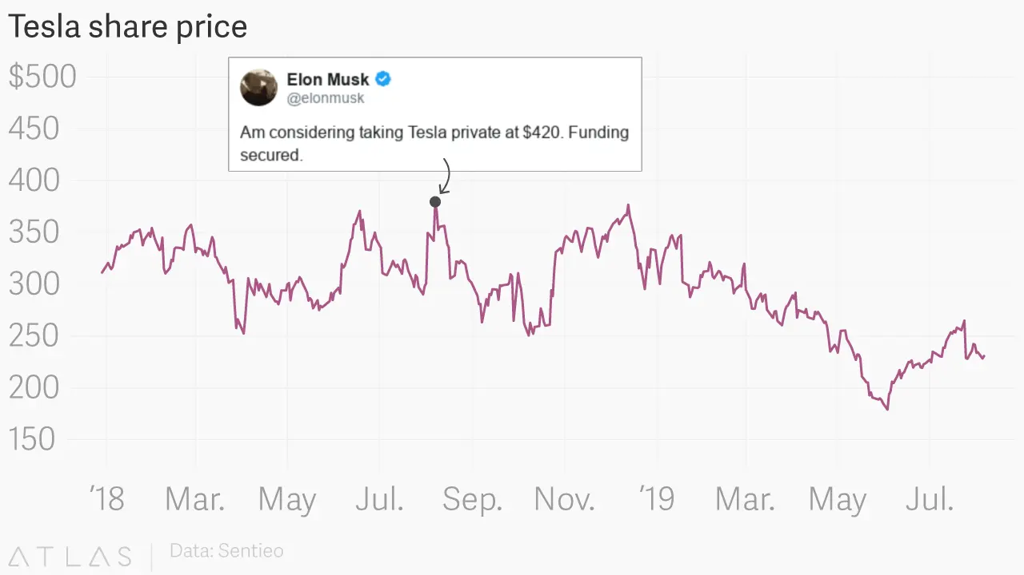
Approach

Slide 7
Motivation
we would like to see how we could use machine learning to predict the fluctuation of the entire market or a particular stock based on tweets made by influential personalities.

Slide 8
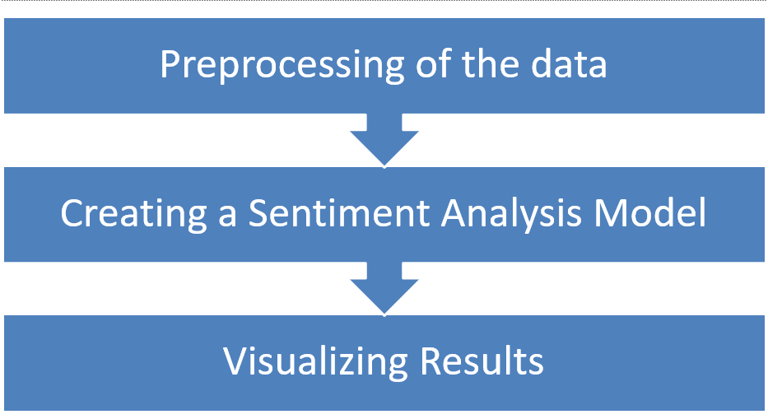
Procedure

Slide 9
Preprocessing of the data
Removing the blank fields in tweets and stock price csv files.
Removing the special characters.
Merging the data.

Slide 10
Implementation Details
We did twitter sentiment analysis using NLTK Vader and text blob.
calculated the percent change for stock prices.
Partition data into train and test data set.
To predict next year's data, we used multiple learners: Linear regressor, MLP regressor, Random forest regressor.

Slide 11
Linear Regression Algorithm
Linear regression is perhaps one of the most well-known and well understood algorithms in statistics and machine learning. It is based on supervised learning.
It performs a regression task. Regression models a target prediction value based on independent variables. When training the model, it fits the best line to predict the value of y for a given value of x.

Slide 12
MLP Regressor Algorithm
A multilayer perceptron is a class of feedforward artificial neural network (ANN).
Multilayer Neural Networks has one input layer and one or more hidden layers and an output layer. It has an activation function and a cost function for the layers.

Slide 13
Random Forest Algorithm
Random forest is a supervised learning algorithm. The "forest" it builds, is an ensemble of decision trees, usually trained with the “bagging” method. The general idea of the bagging method is that a combination of learning models increases the overall result.
It helps to overcome overfitting of training set.

Slide 14
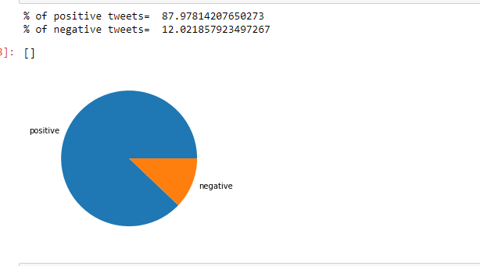
Test Results

Slide 15
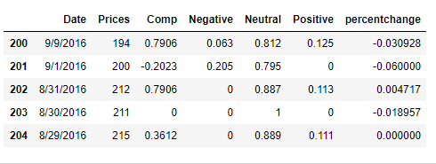
Test results
Calculating the percentage change from stock values

Slide 16
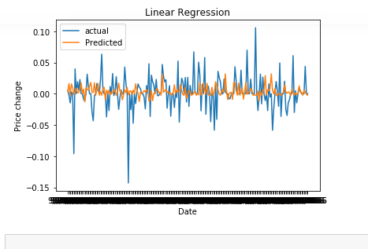
Test Results
Prediction graph for linear regression(Accuracy=34%).

Slide 17
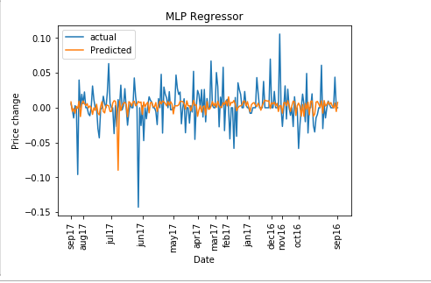
Test Results
Prediction graph for MLP(Accuracy:45%)

Slide 18
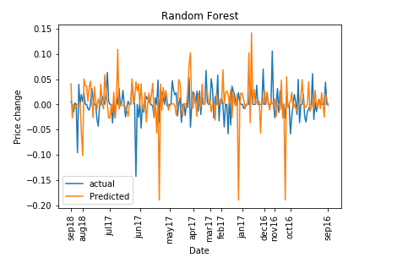
Test Results
Sentiment Analysis using random forest with NLTK classifier gave the best results
Accuracy of random forest in predicting 2018 year stock prices using NLTK: 65%

Slide 19
Conclusion
There are a lot of techniques and tricks used by people to improve their results.
Twitter Sentiment Analysis allows a deeper understanding of how your customers feel. It adds an extra layer to the traditional metrics used to analyze the performance of brands on social media and provides businesses with powerful opportunities.
If predicting stocks were that simple then life would be different.

Slide 20
Thank You!!

